Slide 1

Introduction to Parallel Computing
By
Dr. Nileshchandra Pikle
Assistant Professor
Indian Institute of Information Technology Nagpur

Slide 2
Agenda
Syllabus, Course outcomes, Evaluation Strategy
Sequential vs Parallel Work
Parameters to increase performance of CPU
Limitations of single core
Limitations of multi-core

Slide 3
Syllabus
Part 1: Introduction to Parallel Computing, Limitations of single core CPU performance, Need for multi-core, Parallel computing architectures – Shared and distributed memory architectures, Flynn’s Taxonomy, Dependence Analysis.
Part 2: Shared memory Architecture – OpenMP, Performance Metrics – Speedup, Parallel Efficiency, Scalability.
Part 3: Shared memory Architecture – CUDA
Part 4: Distributed memory Architecture – MPI
Part 5: Parallel Algorithms

Slide 4
Course Outcomes
Student will be able to identify the dependency in computation
Student will be able to analyze and decompose the computation into parts for parallel computation
Student will be able to apply OpenMP, MPI and GPU programming for the development of parallel programs
Student will be able to do simulation on parallel computing architectures and do performance evaluation amongst the parallel algorithms

Slide 5
Evaluation Strategy
Evaluation Type | Weightage
Sessional 1 | 15 Marks
Sessional 2 | 15 Marks
End Sem Exam | 50 Marks
Lab Evaluation + Attendance | 100 Marks (* will be scaled down to adjust 100 marks)

Slide 6
Sequential vs Parallel

Slide 7

Sequential vs Parallel
Scenario 1
Task: Digging a 20 meter big hole
Resources: 1 Worker, 1 shovel
Efficiency: 1 meter per hour
Time: 20 Hrs.

Slide 8

Sequential vs Parallel
Scenario 1
CPU | Single Core
Clock Frequency | 1 GHz
Pipelining | No
Branch Prediction | No
Cache | No

Slide 9

Sequential vs Parallel
Scenario 2
Task: Digging a 20 meter big hole
Resources: 1 Worker, Mechanical device
Efficiency: 1.5 meter per hour
Time: 13.33 Hrs.

Slide 10

Sequential vs Parallel
Scenario 2
CPU | Single Core
Clock Frequency | 4 GHz
Pipelining | YES
Branch Prediction | YES
Cache | Large

Slide 11
Sequential vs Parallel
Scenario 3
Task: Digging a 20 meter big hole
Resources: 4 Workers, Mechanical devices
Efficiency: 6 meter per hour
Time: 3.33 Hrs.

Slide 12

Sequential vs Parallel
Scenario 3
CPU | Quad Core
Clock Frequency | 4 GHz
Pipelining | YES
Branch Prediction | YES
Cache | Large

Slide 13
Sequential vs Parallel Computing
Sequential computing:
Problem (program) is broken into stream of instructions that are executed sequentially one after the other on a single processor (core)
Only one instruction executes at a time
Parallel Computing:
Problem is broken into parts that can be solved concurrently
Each part is further broken into stream of instructions
Instruction from different parts execute simultaneously on different processors

Slide 14

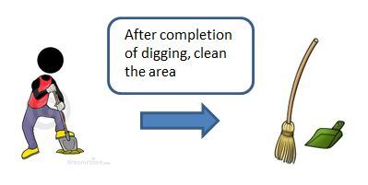
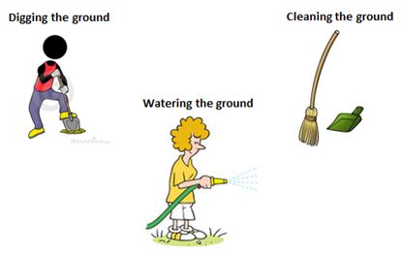
Sequential vs Parallel Computing
Essentially parallel computing is doing things simultaneously
Same things or different things
Solving a larger problem
Doing same things simultaneously
Sequential working
Doing different things simultaneously

Slide 15
Sequential vs Parallel Computing
Essentially parallel computing is doing things simultaneously
Same things or different things
Solving a larger problem
Resource 1
Program 1
Program 2
Instruction 1
Instruction 1
Instruction 1
Instruction 2
Instruction 2
Instruction 2
Instruction 3
Instruction 3
Instruction 3
Instruction 4
Instruction 4
Instruction 4
Instruction 5
Instruction 5
Instruction 5
Instruction 6
Instruction 6
Instruction 6
Instruction 7
Instruction 7
Instruction 7
Instruction 8
Instruction 8
Instruction 8
Sequential execution

Slide 16
Sequential vs Parallel Computing
Essentially parallel computing is doing things simultaneously
Same things or different things
Solving a larger problem
Program 1
Program 2
Instruction 1
Instruction 1
Resource 1
Resource 2
Instruction 2
Instruction 2
Instruction 1
Instruction 5
Instruction 3
Instruction 3
Instruction 2
Instruction 6
Instruction 4
Instruction 4
Instruction 3
Instruction 7
Instruction 5
Instruction 5
Instruction 4
Instruction 8
Instruction 6
Instruction 6
Instruction 7
Instruction 7
Doing same things simultaneously
Instruction 8
Instruction 8

Slide 17
Sequential vs Parallel Computing
Essentially parallel computing is doing things simultaneously
Same things or different things
Solving a larger problem
Program 1
Program 2
Resource 1
Resource 2
Instruction 1
Instruction 1
Instruction 1
Instruction 1
Instruction 2
Instruction 2
Instruction 2
Instruction 2
Instruction 3
Instruction 3
Instruction 3
Instruction 3
Instruction 4
Instruction 4
Instruction 4
Instruction 4
Instruction 5
Instruction 5
Instruction 6
Instruction 6
Instruction 7
Instruction 7
Instruction 8
Instruction 8
Doing different things simultaneously

Slide 18
Increasing CPU Performance

Slide 19

How to increase the CPU performance?
Clock
Frequency
Pipeline
Cache
RAM
Transistors
Multicore

Slide 20
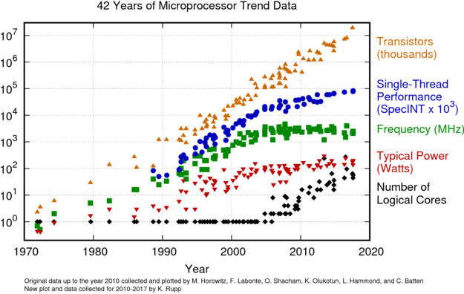
How to increase the CPU performance?
Clock
Frequency
Pipeline
Cache
RAM
Transistors
Multicore

Slide 21
How to increase the CPU performance?
Clock
Frequency
Pipeline
Cache
RAM
Transistors
Multicore
Increase clock Frequency
More power consumption
More Heat Dissipation
Powerful Cooling solutions
More Energy

Slide 22
How to increase the CPU performance?
Clock
Frequency
Pipeline
Cache
RAM
Transistors
Multicore
Smaller Transistors
More Transistors per chip
More Performance

Slide 23
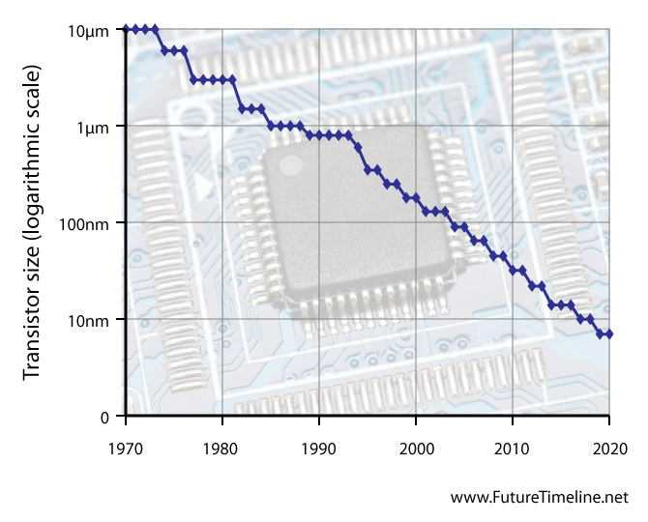
How to increase the CPU performance?
Clock
Frequency
Pipeline
Cache
RAM
Transistors
Multicore

Slide 24
How to increase the CPU performance?
Clock
Frequency
Pipeline
Cache
RAM
Transistors
Multicore
What next?

Slide 25
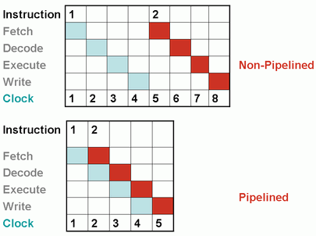
How to increase the CPU performance?
Clock
Frequency
Pipeline
Cache
RAM
Transistors
Multicore

Slide 26

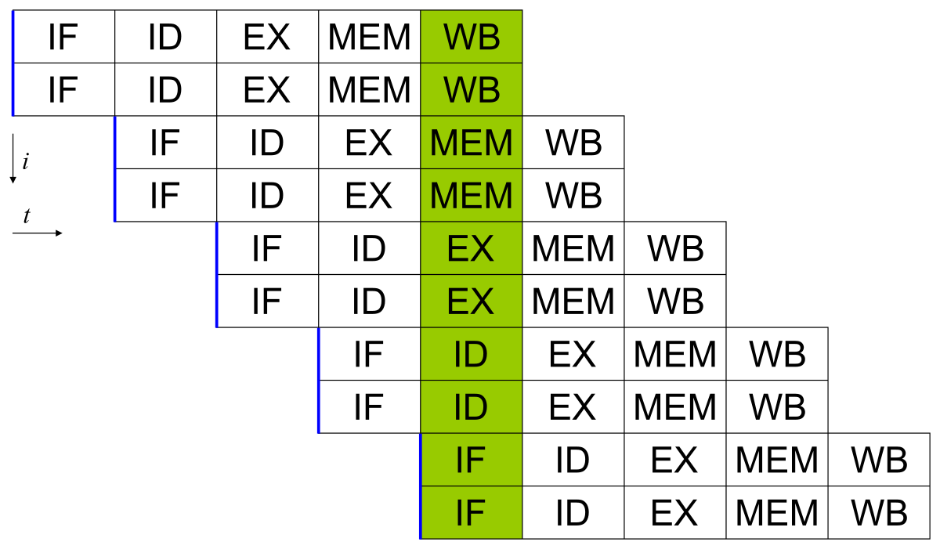
How to increase the CPU performance?
Clock
Frequency
Pipeline
Cache
RAM
Transistors
Multicore
Superscalar Pipeline

Slide 27
How to increase the CPU performance?
Clock
Frequency
Pipeline
Cache
RAM
Transistors
Multicore
May improve the performance by avoiding swapping

Slide 28
How to increase the CPU performance?
Clock
Frequency
Pipeline
Cache
RAM
Transistors
Multicore
May improve the performance but don’t match size with RAM

Slide 29
How to increase the CPU performance?
Clock
Frequency
Pipeline
Cache
RAM
Transistors
Multicore
Cores
Processor
Socket
Base Board

Slide 30
Number of cores in a CPU
Normal PC
Dual core, Quad Core, Hexa core, Octa Core, sixteen core etc.
Workstations
32 cores, 64 cores or even 128 cores

Slide 31

If a Mat Mult program is executed which one will run faster?
Dual
Core
Quad
Core
Hexa
Core
Octa
Core

Slide 32
Parallel Computing
Core 0
Core 1
Core 2
Core 3
Data
Multicore Processor

Slide 33
Parallel Computing
Core 0
Core 1
Core 2
Core 3
Data
Multicore Processor

Slide 34

Why number of cores in a CPU are limited in number?
Size
Complexity
Cost
Heat/
Power

Slide 35
Thank you

